Slide 1

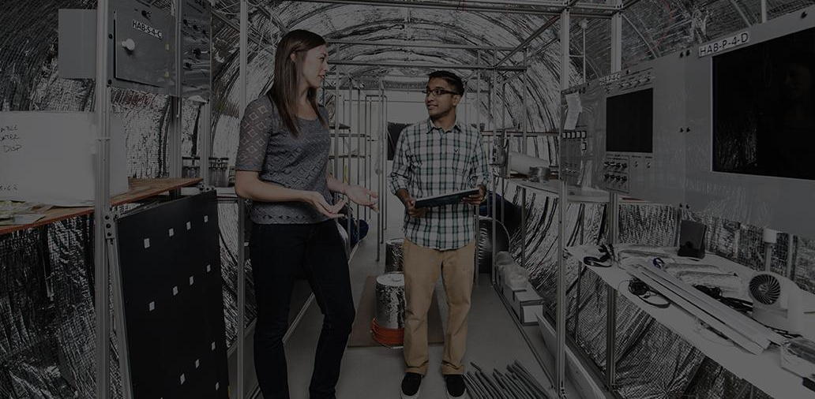
Final Project: V2V Broadcasting Protocol
Kevin Jones, Isha Burange, Bhoomika Singla, Kiran Jojare
Network Systems Fall 2022
College of Engineering, University of Colorado Boulder

Slide 2


Motivation
As per many research surveys, rear-end collisions occurs mostly due to:
Drivers maintain lesser headway time than is recommended.
Drivers have limited line of sight.
Bad weather like fog or low visibility.
To overcome this problem we need a way to:
Detect the crash event and relay it to drivers in back.
Provide more time to driver to prevent the crash.
Enable vehicle communication in bad weather conditions or low visibility.
Simply Warning of Potential Hazard Would be Enough !

Slide 3
Approach
Create a vehicle broadcast network
Broadcast location message across platoon of vehicles within that network
Maintain proximity tables for each vehicle
In case of crash, broadcast emergency message to the vehicles in the proximity range
Upon receiving emergency message, process and respond accordingly

Slide 4
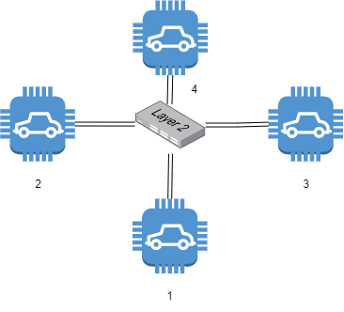
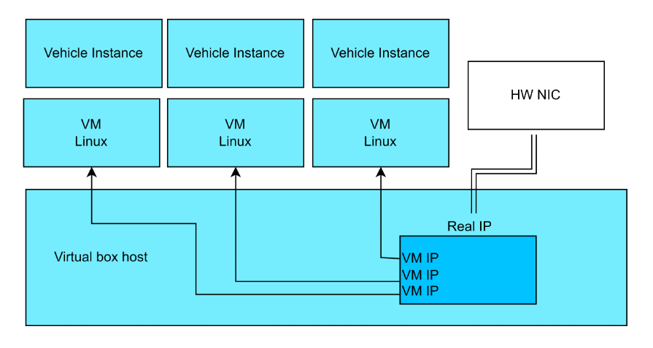
V2V Model
The system was modeled as several vehicles attached to a single switch
Implemented as vms with a virtual switch
Messages were broadcasted to simulate over the air transmission
Broadcast vehicle ID, time and location and update proximity table at regular intervals for effective collision detection
Broadcast crash message in case of emergency event
Recipient vehicle must decide whether to accept and send ack or reject the message based on proximity range

Slide 5
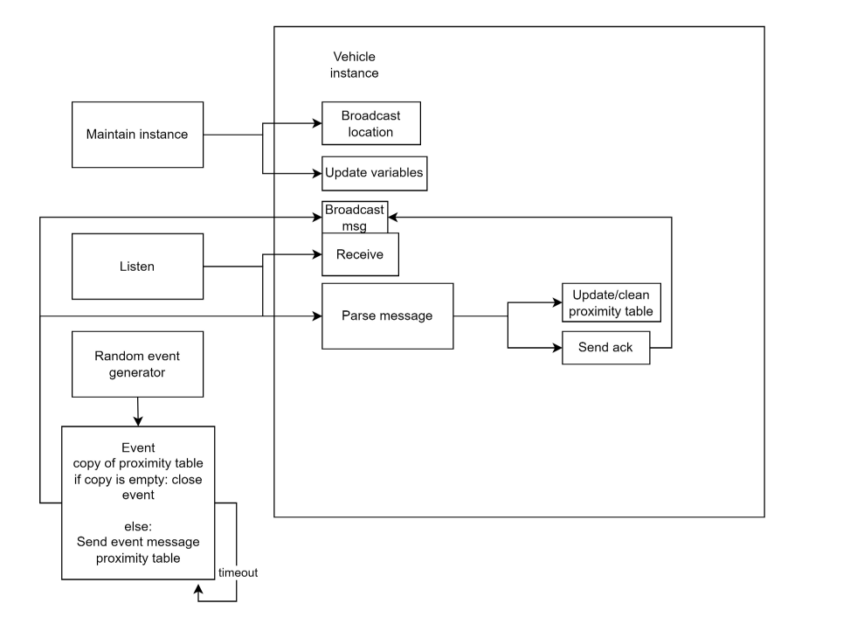
Program Modules

Slide 6
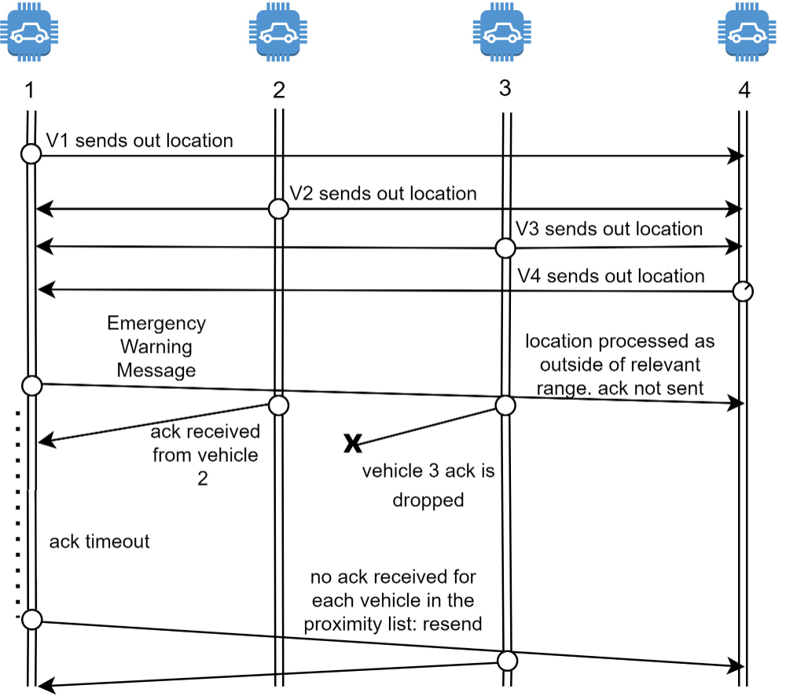
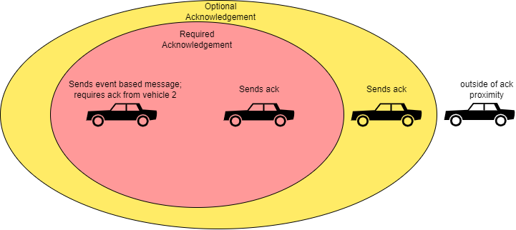
Example Flow
Vehicles establish who is around them
Vehicle 1 sends out an emergency message
The missing ack from vehicle 3 initiates resend
The new emergency message only needs an ack from vehicle 3
Alternative considered

Slide 7
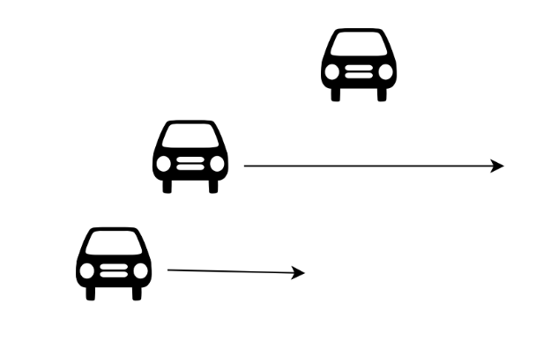
Demo test case
3 vehicle instances were initialized, 1 standing still, and 2 moving at different speeds
An emergency message is sent out as the 2 vehicles pass by
An emergency message is sent out with only one of the other vm close by
Vehicles in ack table respond. Acked vehicles are dropped from the event proximity table as responses come in

Slide 8
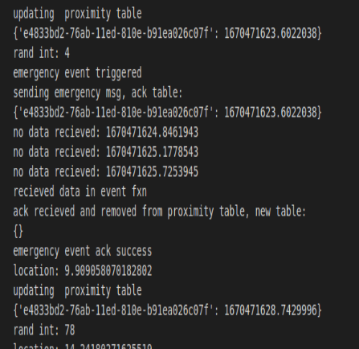
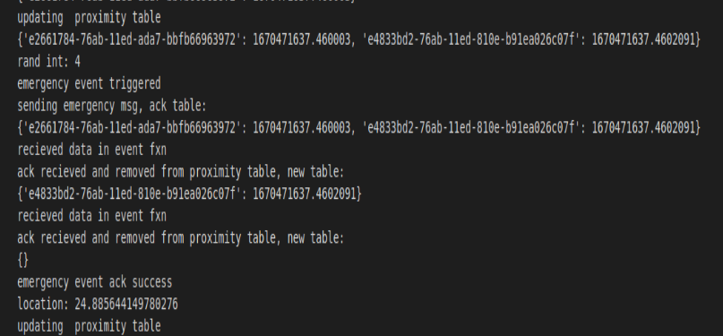
Demo

Slide 9
Future Scope
Create a multi lane approach for solution.
Containerised the vehicle module for scalability.
Create a actual H/W Vehicle Prototype.
Integrate Emergency Systems(911) within software.
Multiple ADAS Applications inside autonomous vehicle.
Provide more security.

Slide 10
Thank You ! Any Question ?

